Slide 1
MIND MAPPING
How to Use the Brain More Effectively
Making and Using a Mind Map

Slide 2
Why use a Mind Map?
VIDEO - MAKING AND USING A MIND MAP – BUZAN
Mind map video –
How to Mind Map video

Slide 3
The Mind Map
How To Make a Mind Map®
The 'Laws of Mind Mapping' were originally devised by Tony Buzan when he codified the use of imagery, colour and association and coined the phrase 'Mind Mapping'. In the intervening 30 plus years, there have been many variations on the original 'Mind Map® ' and the widespread usage of mapping software of various sorts, has dramatically changed what is possible. The picture on the next slide is based on Buzan's structure (details available in his many books) Remember that even though there are governing “principles” for mind-mapping, maps can be used in many different ways and variations on these rules or 'laws' are often sensible and appropriate - as long as they are based on an understanding of why the laws exist and what they are trying to help the mind mapper to achieve.

Slide 4
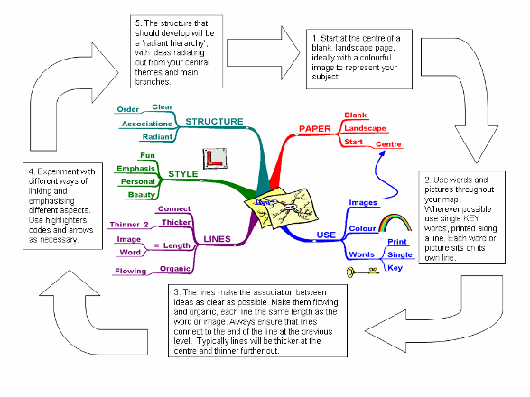
mindmanager version 6, how to make a mind map

Slide 5
1. Take a blank piece of paper, A4 or larger | Blank paper allows 360º of freedom to express the full range of your cortical skills, whereas pre-drawn lines restrict the natural flow of your thoughts
2. Use the paper in landscape orientation | Words and images have more space in the direction we write, so they don’t bump into margins as quickly
3. Start in the center | Thoughts start in the centre of our mental world. The Mind Map® page reflects this
4. Make a central image that represents the topic about which you are writing /thinking use at least three colors keep the height and width of the central image to approx. 2’’ or 5 cm (proportionately larger for bigger paper) allow the image to create its own shape (do not use a frame) | A picture is worth a thousand words. It opens up associations, focuses the thoughts, is fun and results in better recall: colors stimulate the right cortical activity of imagination as well as capturing and holding attention this size gives plenty of space for the rest of your Mind Map®, while making it large enough to be the clear focus of the topic the unique shape makes it more memorable and enjoyable. A frame makes the centre a monotony of shape and disconnects the branches
mindmanager version 6, how to make a mind map

Slide 6
5. The main themes around the central image are like the chapter headings of a book print this word in CAPITALS or draw an image place on a line of the same length the central lines are thick, curved and organic i.e. like your arm joining your body, or the branch of a tree to the trunk connect directly to the central image | The main themes, connected to the central image on the main branches, allow their relative importance to be seen. printing (versus cursive) allows the brain to photograph the image thus giving easier reading and more immediate recall word length equals line length. An extra line disconnects thoughts, length accentuates the connection curved lines give visual rhythm and variety and so are easier to remember, more pleasant to draw and less boring to look at. Thicker central lines show relative importance Connected to the image because the brain works by association not separated, disconnected lines
6. Start to add a second level of thought. These words or images are linked to the main branch that triggered them. Remember: lines connect are thinner words are still printed but may be lower case | Your initial words and images stimulate associations. Attach whatever word or image is triggered. Allow the 'random movement of your thought; you do not have to ‘finish’ one branch before moving on connected lines create relationships and a structure. They also demonstrate the level of importance, as from a branch to a twig the size and style of the letters provide additional data about the importance and meaning of the word/image
mindmanager version 6, how to make a mind map

Slide 7
7. Add a third or fourth level of data as thoughts come to you Use images as much as you can, instead of, or in addition to the words Allow your thoughts to come freely, meaning you ‘jump about’ the Mind Map® as the links and associations occur to you | Your brain is like a multi-handed thought-ball catcher. The Mind Map® allows you to catch and keep whatever ‘thought ball’ is thrown by your brain
8. Add a new dimension to your shapes -- add depth around the word or image | To make some important points stand out
9. Sometimes enclose branches of a Mind Map® with outlines in colour enclose the shape of the branch. Hug the shape tightly use different colours and styles | The outlines will create unique shapes as you find in clouds and will aid your memory these provide immediate visual linking. They can also encourage follow-up and remind you of action you need to take they can also show connection between branches by using the same colour outline
mindmanager version 6, how to make a mind map

Slide 8
10. Make each Mind Map® a little more: BEAUTIFUL ARTISTIC COLOURFUL IMAGINATIVE and DIMENSIONAL | Your eyes and brain will be attracted to your Mind Map® It will be easier to remember It will be more attractive to you (and to others as well)
11. Have fun! Add a little humour, exaggeration or absurdity wherever you can | Your brain will delight in getting the maximum use and enjoyment from this process and will therefore learn faster, recall more effectively and think more clearly
mindmanager version 6, how to make a mind map

Slide 9
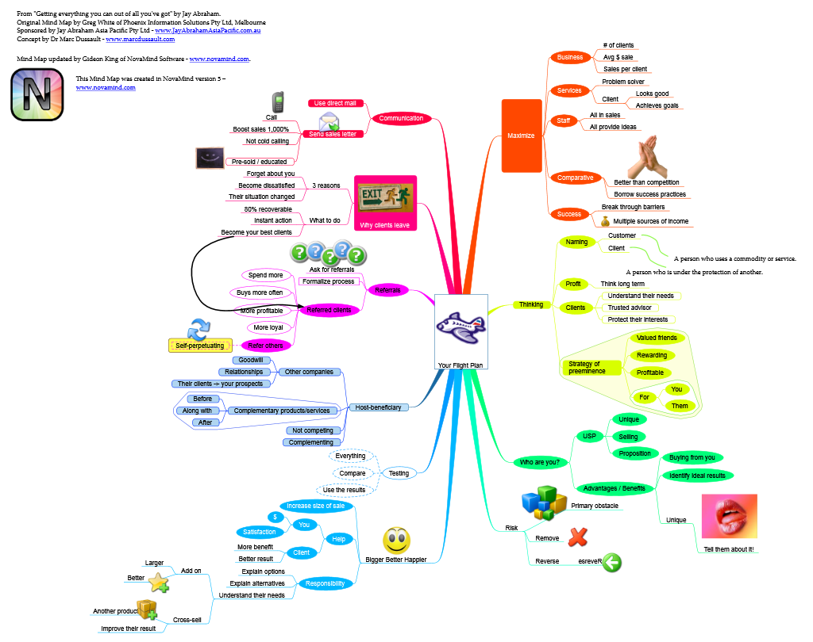
Mind mapping examples
Mind Map Example

Slide 10
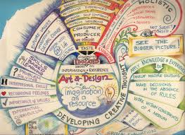
Sample mind maps

Slide 11
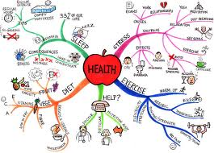
Sample Mind Map

Slide 12
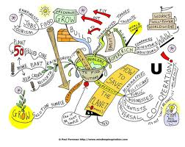
Sample Mind map

Slide 13
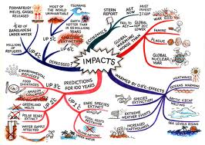
Sample Mind Map

Slide 14
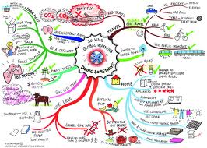
Sample mind map

Slide 15
REQUIREMENTS
TITLE
5-6 main branches – key words that represent ideas
Outer branches should include (key words)
Follow the guidelines for mindmapping
Use color, line, and images (must be an image in the middle AND at least 2 in the outer branches)
TITLE: (at top of page)
Your NAME and date – on back of page
Legible
Useful

Slide 16
REQURIMENTS - FORMATTING
Follow the guidelines for mindmapping
Use color, line, and images (must be an image in the middle AND at the outer branches)
TITLE: (at top of page)
Your NAME – on back of page
Legible
Useful

